Slide 1
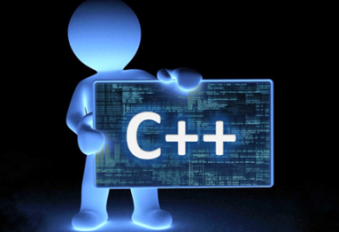

Guess The Number
By Nigel & Ray
CIS 27
C++ Data Structures and algrithms

Slide 2
Introduction
This project is a game that stores different decisions and information while checking a bunch of methods.
Our goal was to design an efficient algorithm that could guess a random number chose by the computer.

Slide 3
Information Needed
-variables that would hold different things.
-we need a function to randomly chose a number
-A function that stores difficulty for user who is guessing the computer’s chosen number.
-True or False statements to confirm that users guess is within the permitted size
-A void function that will check if the guess is too low or too high from the random number generated.

Slide 4
Game Modes
We created 2 ways to play our Guessing game. This first mode will be based around the computer choosing a number and the user of the computer guessing the number correctly.
Our 2nd game mode will be based on the opposite situation. In this case a user will chose the number guessed, and we will try and have the computer try and guess the number.

Slide 5
Difficulty
In our game we wanted to give 3 types of ways to play. We have and Easy , Medium , and Hard difficulty.
-Easy mode = 7 guesses
-Medium mode = 5 guesses
-Hard mode = 3 guesses
We have a void function that will hold the value entered by the user for difficulty.

Slide 6
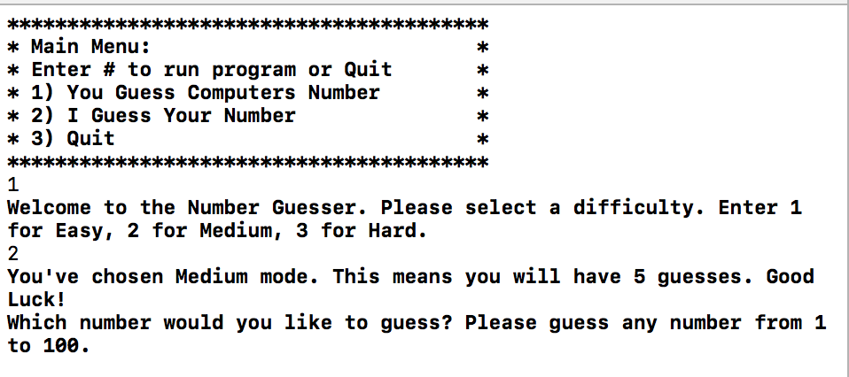
Gameplay

Slide 7
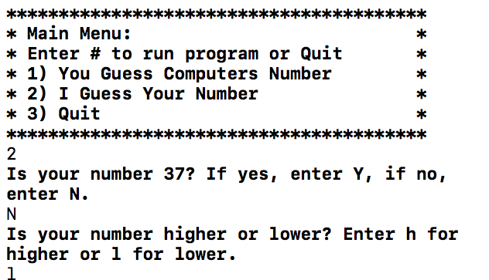
Gameplay

Slide 8
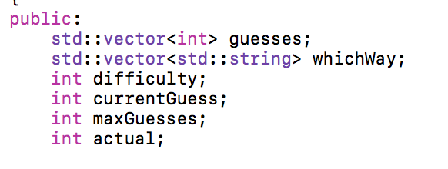
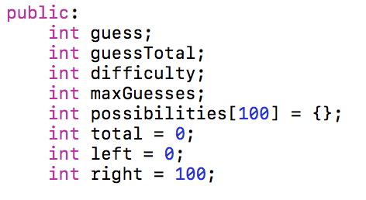
Underlying Data Structures
-Vectors
-Arrays

Slide 9
Filesharing
We stored all the values into a CSV. Because the values were placed here we wanted to be able to write over them and interact with the values.
Therefore if any new users are to play our game, whatever number they choose to deal with while playing will get added to our CSV file.

Slide 10
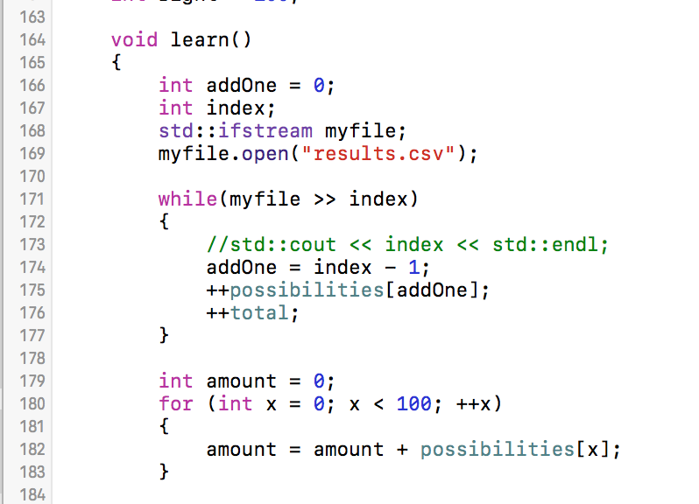
Filesharing

Slide 11
Data Size
-Originally we set up a survey to see what numbers were commonly guessed from 1-100. We used those data points for the computer to be able to guess our number within playing the game.
-The survey contained 128 original samples of numbers from 1-100. We discovered that some numbers were missed in our original sample. So we added every number from 1, 2, 3, ….100 to the 128 sample data points to make sure that our computer could guess any number

Slide 12
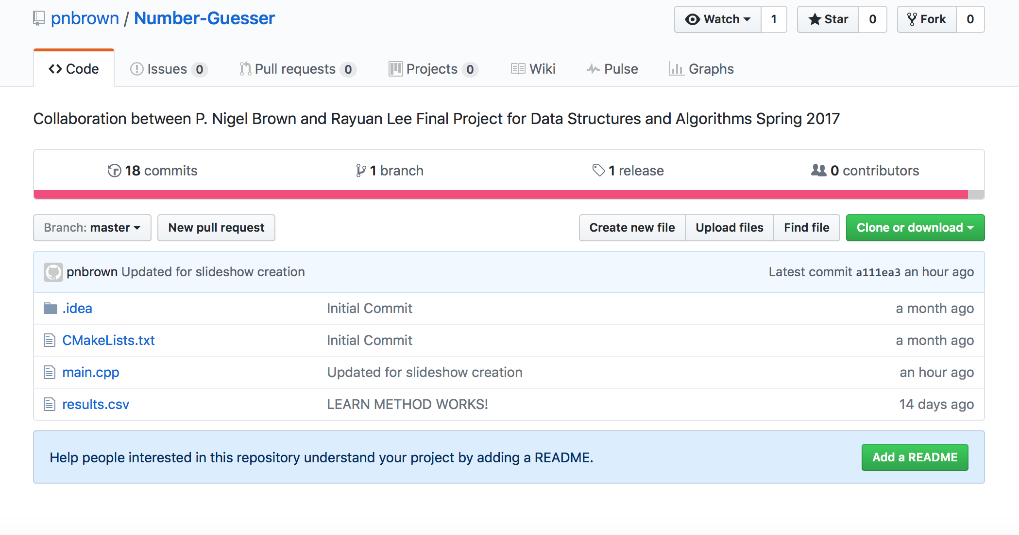
Connecting
To make continuous updates to our project we pushed updates into our project file on GitHub.

Slide 13
Issues with the code
-A problem we had was creating the 2nd class which is the computer’s guess.
-There was struggle with filestreaming within our program. We wanted to connect data points from a survey to the computer.
-We have to limit the amount of guesses that the computer can have(?)
-Every number wasn’t accounted for from the survey. We had to add 1-100 in addition to our survey responses

